Slide 1


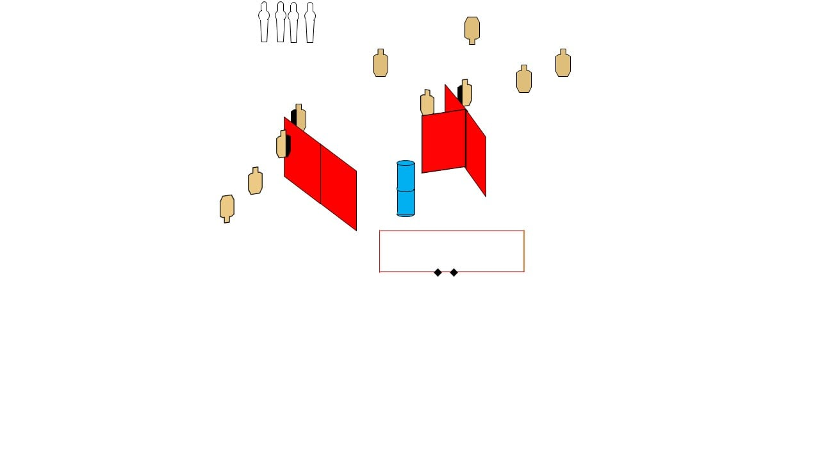
 | Dothan Gun Club – USPSA Match Rainy Day Course Designer : Danny Minter (Facebook)
Round Count 24 rounds 4 poppers 10 USPSA
Equipment List 2 medium fault lines 6 wall feet

Slide 2
Rainy Day
Written Stage Briefing
Rainy Day is a 24 round, 120 point, Comstock course of fire. There are 10 USPSA targets and 4 poppers. The best 2 hits on paper will score, and steel must fall to score. The start signal is audible.
Handgun start position is both feet on X’s, wrists below belt. Handgun is loaded and holstered.
PCC start position is both feet on X’s, stock on belt. Carbine is loaded with safety on.
On start signal engage targets as they become available from within the shooting.

